Slide 1
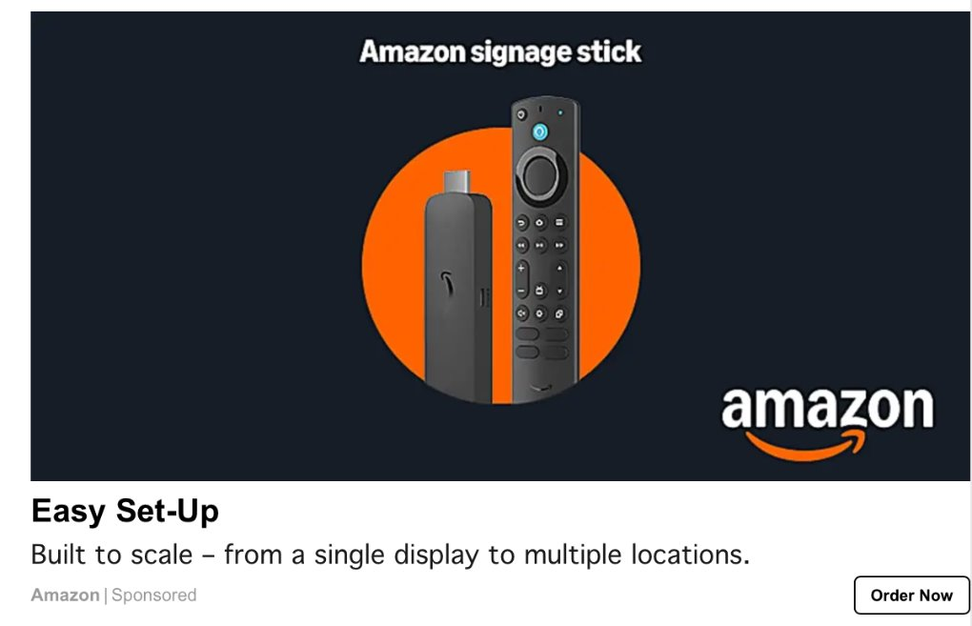
Amazon: Go-To-Market for Signage Stick
Client Need
Amazon Device Solutions was launching a new digital signage stick and was in need of a marketing partner to assist with go-to-market strategy and execution.
Support & Results (initial 3-month time period)
The Affirma team supported the following:
Design and visual identity support
Explainer video scripting
SEO for product page
UX for product page desktop & mobile
Demand Gen strategy
  9.6 million impressions in 1 paid ad channel!
Trade publication media & sponsored content
  4 initial publications
  Over 100,000 impressions
Micro-influencer program and execution

